Slide 1
Modelling catchment-scale evapotranspiration and net primary production: towards understanding carbon and water trade-offs in communal rangelands
Tony Palmer*, Rhodes University, Makhanda South Africa
TOCASA Final Workshop, Matatiele, 2 March 2022

Slide 2
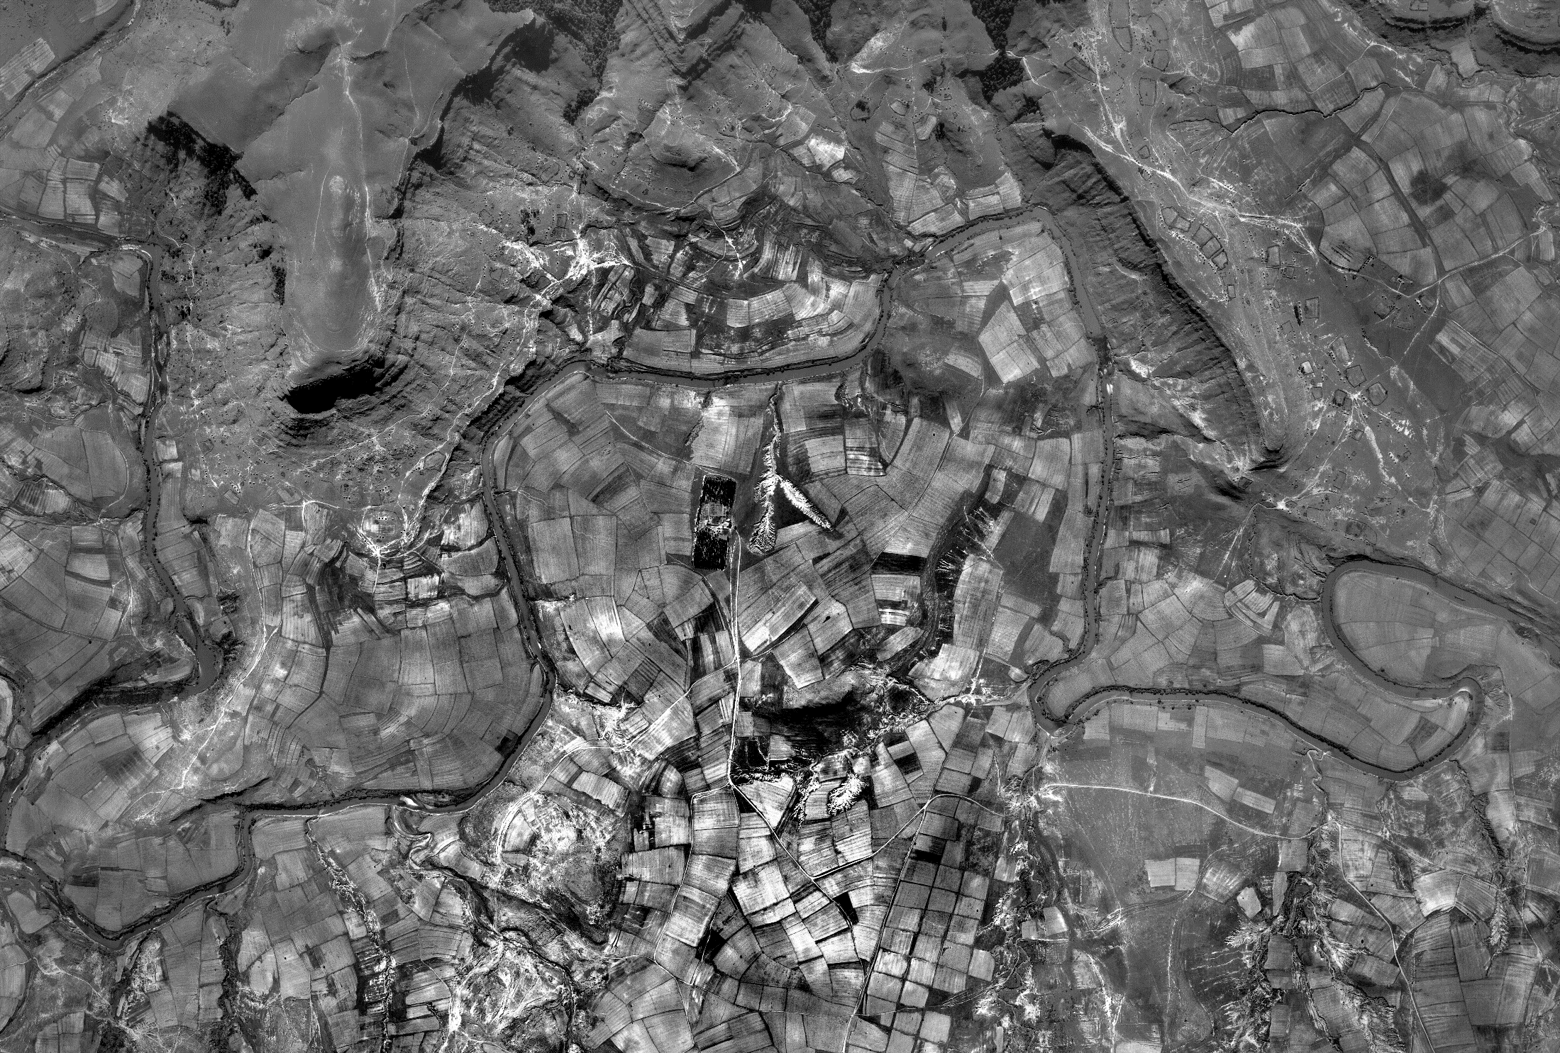
Introduction and History
Betterment Planning in 1950s
Grasslands were converted in arable land
These led to physical changes to the landscape drainage patterns
1958
Dryland cropping areas

Slide 3
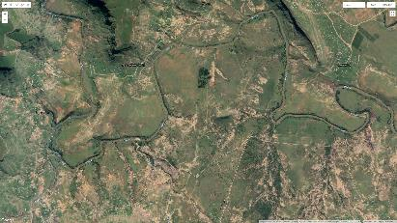
What have been the drivers of change in the intervening 62 years?
Reduction in cropping activity
Primary focus on livestock production, with highest grass production on run-on areas
Sustained high livestock numbers of cattle, sheep and goats for 80 years
Invasion of hill-slope seeps by Acacia dealbata
Invasion of riparian zone by Acacia mearnsii
Landscape engineers (termites, earthworms and mole-rats) re-engineering landscape
1958
2020

Slide 4
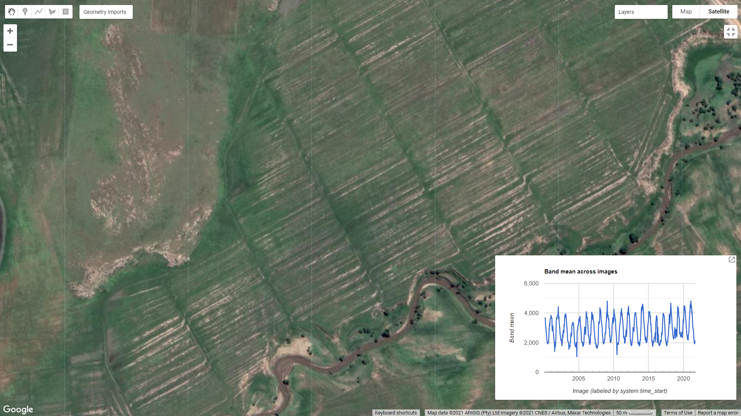
Grazing meadows
Run-on and run-off
Little evidence of recent cultivation
Man abandoned arable lands now provide year round grazing

Slide 5
What does satellite imagery tell us about how plant growth occurs on these landscapes?
Sensors on satellites provide us with plant growth. This is possible because the water in the plants reflected near-infra red light. This is called a green index, and it shows us where plants are actively growing, and also where erosion and cultivation is occurring.
Dark green colour indicates trees and actively growing crops.
White colour indicates cleared areas with no vegetation
Human settlement and Betterment has resulted in new landscape patterns – villages, cultivated areas and grazing areas

Slide 6
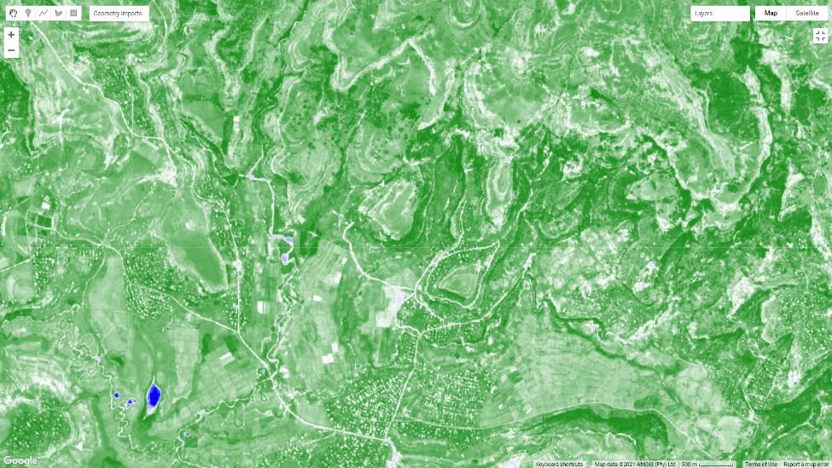
Nkasela
Sentinel 2 NDVI for growing season 2021

Slide 7
These patterns of change do not follow trajectory to native grassland
Novel landscape develops
different suite of species
apparently very productive, but contested
Livestock favour the run-on areas
Novel landscape patterns
hotspots of plant active growth
abandoned arable land
crop residues

Slide 8
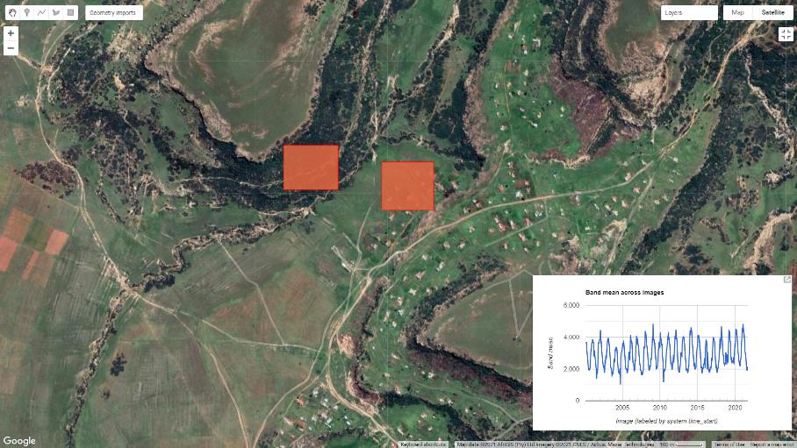
Is there any sign of system run-down?
Have we reached an alternative stable state?
dywabusi
Grassland

Slide 9
Objective of the research
To provide verifiable, evidence-based estimates of evapotranspiration from both wattle-invaded areas, and un-disturbed native grassland. This can be used to justify the cost of wattle removal.

Slide 10
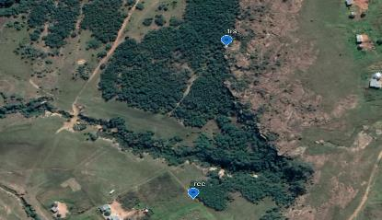
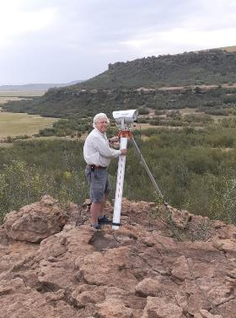
Large aperture scintillometer
Daily ET comparing grassland and silver wattle

Slide 11
Results
Total ET for the invaded areas was 3x higher (1348 mm) than un-invaded grassland (509 mm), and exceeded rainfall by approximately 300%.
This extra ET is coming from the hill-slope seeps.
This water could be used for
grass production in the adjacent water meadows
contribute to spring flow
added to downstream flow

Slide 12
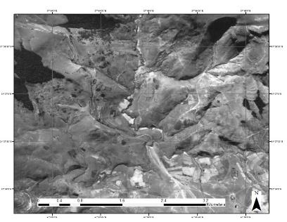
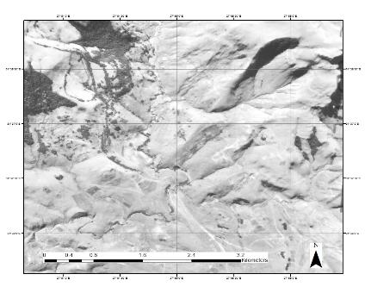
What is the C carbon being captured by black wattle?
Where surveyed the density and size classes of black wattle along an age-gradient. We determined the age by locating different age stands from historical aerial photographs.
1957
1978

Slide 13
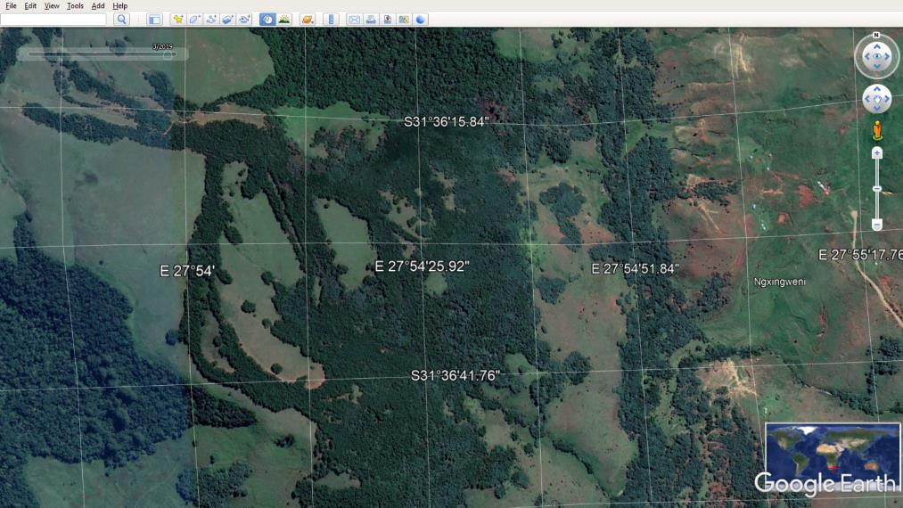
2021

Slide 15
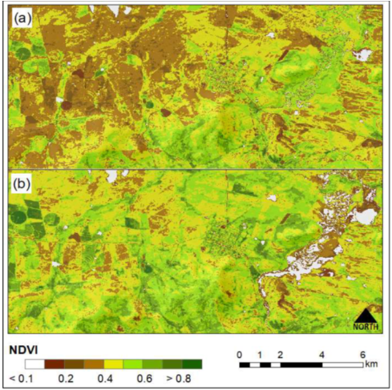
2019/02/01
2019/02/23
Sentinel-2 NDVI showing the rapid greening up of the highly productive floodplain.

Slide 16
Conclusions
Evapotranspiration by silver wattle along seep-lines and in the riparian zone resulted in substantial loss of water through evapotranspiration.
This is a net loss of primary production that could be used by livestock
The continued removal of silver wattle from seep-lines and the riparian zone will enhance forage production for livestock by up to 60% in invaded areas and adjacent grazing meadows.
The low SOC as a result of historical cultivation represents an opportunity for C storage

Slide 17
Recommendations
For silver wattle, focus clearing activity and post-clearing restoration on hill-slope seeps.
As black wattle is now a valuable crop for export, it is difficult to prevent people from felling medium-sized trees. However, it would be better to thin wattle, preserve large trees, and allow grass to grow under the canopy.

Slide 18
Thank you
Supported by United Kingdom Research and Innovation grant through the Biotechnology and Biological Sciences Research Council [Grant number BB/S014683]

