Slide 1
Why Black History
Joe Aldred
Broadcaster, Ecumenist, Speaker, Writer
Notes:
Many thanks to Veronica for inviting me here today. One is never quite sure how to approach these occasions. I've decided to do two things. 1) To say something about why I believe ‘Black History’ is important. 2) To flag up 10 areas of historical interest I believe could help to highlight why Black History is important within the context of BHM and as an ongoing enterprise.
It can appear at times that Black history is narrow-minded, exclusive and segregationist. Or that this is about Black People trying to find respectability in a white or even multicultural society from which they feel excluded and disrespected. For me, the Black History project is bigger than that. It is about telling the story of African people in a manner that is holistic that does justice to a civilisation that predates any other. It is also about acknowledging that a people’s history is best researched and told by themselves, since every person or group or nation will inevitably tell their story from their perspective. It is we each and all tell our individual stories that they come together to form one big metanarrative. The metanarrative in Britain and indeed the west has tended to exclude or discriminate against the African story. Hence Black history is revisionist on the one hand; and truth-seeking on the other.

Slide 2
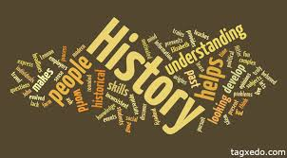
Rationale
The Greek word was borrowed into Classical Latin as historia, meaning ‘written account of past events…recorded knowledge of past events, story, narrative’.
Notes:
What do we mean by History anyway? The Greek word was borrowed into Classical Latin as historia, meaning ‘written account of past events…recorded knowledge of past events, story, narrative’.

Slide 3
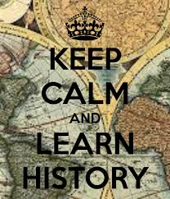
Rationale
History is written by the victors (Walter Benjamin, German-Jewish Marxist literary critic and philosopher).
Until lions have their own historians, the story of the hunt will always glorify the hunter (Richard Reddie)
Notes:
Originally, history was not written down, it was transmitted orally as stories from one generation to another. It is believed that this is how the bible accounts were first formed and transmitted before being written down. We can imagine the way these stories evolved, shaped depending upon who influenced them. We hear about Chinese whispers. ‘History is written by the victors’ says Walter Benjamin, German-Jewish Marxist literary critic and philosopher. And Ricard Reddie in his book Abolition reminds us of an old African proverb ‘Until lions have their own historians, the story of the hunt will always glorify the hunter’. Does that make sense to us?

Slide 4
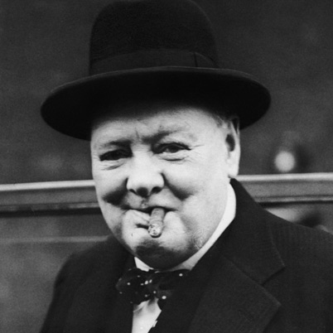
Rationale
Winston Churchill famously remarked in the House of Commons during an exchange with the Prime Minister in the 1930s that he was confident history would find Baldwin wrong - huge grin - "because I shall write that history". (Max Hastings)
Notes:
The great British Institution that is Sir Winston Churchill, is said to have famously remarked in the House of Commons during an exchange with the Prime Minister in the 1930s that he was confident history would find Baldwin wrong - huge grin - "because I shall write that history“, according to writer Max Hastings. This I'm afraid is the case, the truth tends to be what is written, as Pilate said at the trial of Jesus, ‘What I've written I've written’ or as another translation puts it: What I have put in writing will not be changed!

Slide 5
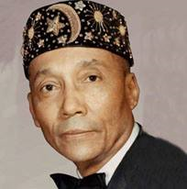
Rationale
History is a weapon in the miseducation of the ‘negro’ (Carter Godwin Woodson)
The late Ivan Van Sertima (Professor of African Studies, USA), Runoko Rashidi, et al., argue that European historical scholarship has been ‘racist’
The African story needs re/telling from African perspective
Notes:
There is a body of black scholarship that believes there is an active conspiracy to mis-educate black people.’ History is a weapon in the miseducation of the ‘negro’’ says Carter Godwin Woodson. The late Ivan Van Sertima, Professor of African Studies, USA, Dr Runoko Rashidi, et al., argue that European historical scholarship has been ‘racist’. The conclusion then is, the African story needs re/telling, and this time by Africans and from an African perspective. So without claiming to be an expert in this area, certainly Im not a historian, more a social commentator on this, I want to suggest ten areas for historical highlight and discussion.

Slide 6
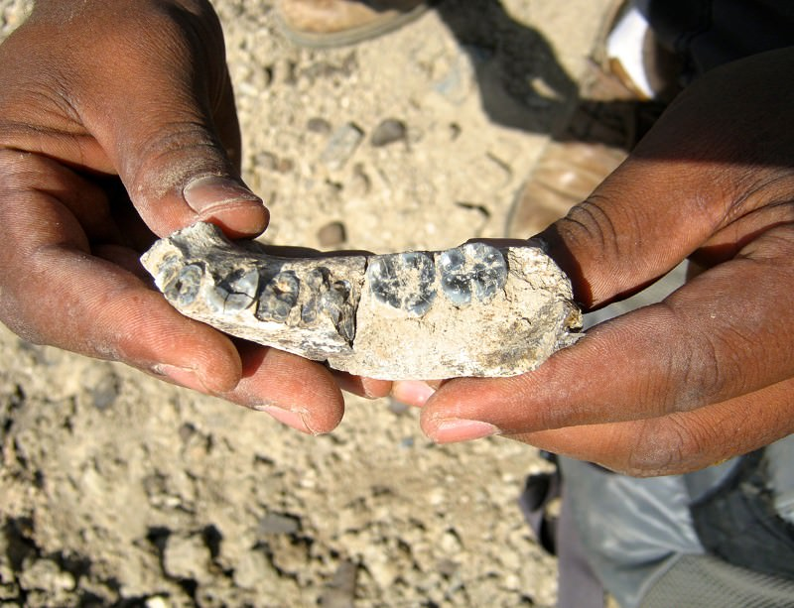
History that needs to be re/told
Human Life (may have) started in Africa – the cradle of civilisation
New DNA evidence suggests "African Eve", the 150,000-year-old female ancestor of every person on Earth, may have lived in Tanzania or Ethiopia (BBC)
Notes:
1) That human life began in Africa and that people of dark hue have populated the earth before lighter skinned people evolved/emerged. This makes Africa the cradle of Human Life, the cradle of civilisation. The BBC reported that New DNA evidence suggests "African Eve", the 150,000-year-old female ancestor of every person on Earth, may have lived in Tanzania or Ethiopia. And Gerald Massey’s ‘A Book of the Beginnings’; Scottish anthropologist David MacRitchie’s ‘Ancient and Modern Britons: A Retrospect’; and Edward Vivian Scobie’s ‘Black Britannia: A History of Blacks in Britain’ all support the idea that Africa is the human starting point and that the first Britains were Africans.

Slide 7
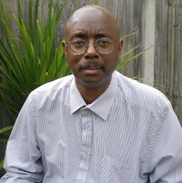
History that needs to be re/told
Africa was a well established land (Robin Walker ‘When we Ruled’)
Notes:
2) Africa was historically a well established land with kingdoms and peoples. Kingdoms rise and fall and so has Africa, but Robin Walker in ‘When we Ruled’ traces this historic reality. Evidence of this is corroborated by the many references to Africa in the Bible, often in glowing terms. There's a new book out titled ‘The glory of African Kings and Queens: Contesting for glory and empire’ by Pusch Commey. Africa today, after colonialism, for example, is not the whole story of Africa.

Slide 8
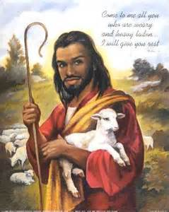
History that needs to be re/told
The Jesus story is more an African story than a European one
Notes:
3) Based on for example texts like ‘Out of Egypt have called my son’ Matt 2.15, Hosea 11.1, have led Cain Hope Felder to say, ‘The sweet little Jesus Boy of the Negro Spiritual was in fact quite black’ (African Heritage Bible). Malcolm X taunted Christians in the US about the blond haired, blue eyed Jesus of the Europeans, and asked where is the God that looks like you? Africans need to to tell the Jesus story not from a European point of view, but from an African one. The Jesus story is more an African story than a European one

Slide 9
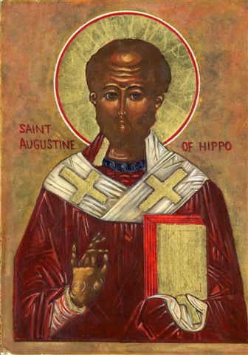
History that needs to be re/told
After Jerusalem, Judea, Samaria…the Christian Gospel went to Africa (Acts 8)
Notes:
4) Many argue that Christianity is a European religion, but biblical history shows that after Jerusalem, Judea, Samaria…the Christian Gospel went to Africa (Acts 8). The Coptic Orthodox of Egypt and the Ethiopean Orthodox church trace their genesis back to the activities of the apostles in the First Century AD.

Slide 10
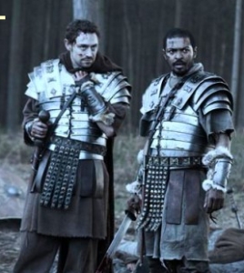
History that needs to be re/told
‘There were Africans in Britain before the English’ (Peter Fryer ‘Staying Power’), e.g. Roman Soldiers at Hadrian’s Wall 3rd Century AD
Notes:
5) Peter Fryer in his classic book ‘Staying Power’ says ‘There were Africans in Britain before the English’. He cites Roman Soldiers at Hadrian’s Wall 3rd Century AD. Fryer reports an encounter between the victorious Roman Emperor, Libya-born Septimius Severus, fresh from his victory over the wild Caledonians, but finding a black soldier flourishing a garland of cypress boughs. The cypress tree was considered sacred to the underworld god Pluto and the Emperor apparently found the combination of that and a black soldier too ominous a bad luck omen. ‘Get out of my sight’, he shouted. To which the black soldier is said to have sardonically replied: ‘You have been all things, you have conquered all things, now, O conqueror, be a god!

Slide 11
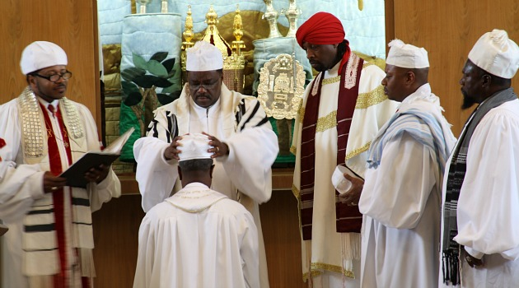
History that needs to be re/told
Israel (may have been or included) black people… Nigerian Black Hebrews, et al
Notes:
6) In keeping with the theme that the world was first Black, some are calling for a rethinking about who ther original Hebrews were – arguing that the people of modern day Israel are not a fair representation of the original Jews. Israel (may have been or included) black people… This picture is of Nigerian Black Hebrews, and there are many other reminders of this idea not least in the Holy land itself, I am told. Rastafarians have long argued that Emperor Hale Selassie is a direct descendant of the line of Judah and of Jesus and that therefore Jesus looked more like Selasse and his people than like Michael Angelo and Europeans

Slide 12
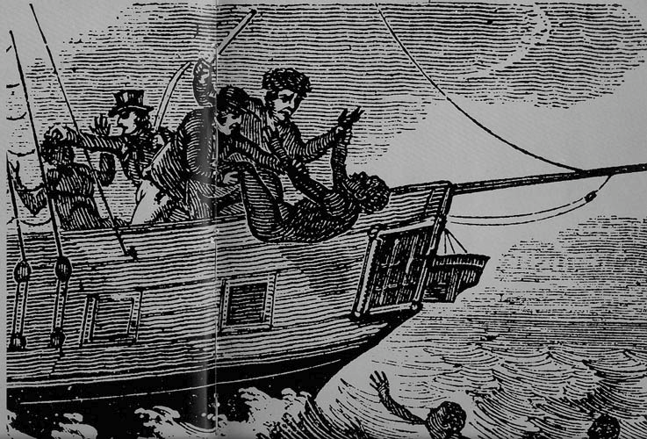
History that needs to be re/told
The Transatlantic Slave Trade probably the greatest genocide ever: 10-100 million African people enslaved, dehumanised, murdered
The Zong
Notes:
7) The story of The Transatlantic Slave Trade probably the greatest genocide ever of 10-100 million African people enslaved, dehumanised and murdered; needs to be told from the perspective of the African. The destruction reaked upon a displaced people is why there is a growing reparations movement against Britain and other European countries that perpetrated and benefited from slavery and the slave trade. The Zong is just one of the slave ships that was used in this enterprise.

Slide 13
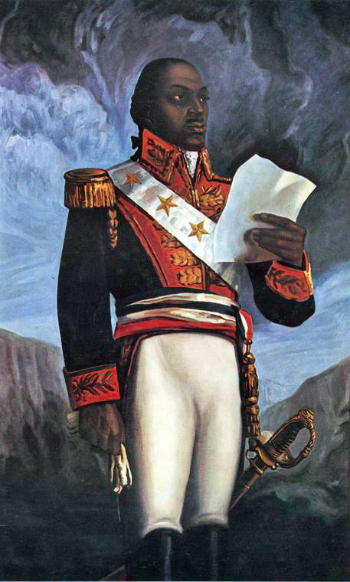
History that needs to be re/told
Slavery and the Slave Trade was not abolished by Wilberforce et al alone but by Black Liberationists like François-Dominique Toussaint Louverture, Sam Sharpe, Paul Bogle, etc
Notes:
8) In similar vein to the last, the ending of Slavery and the Slave Trade is not to be a ‘Wilberfest’ but told from the perspective of the Africans who rose up and fought against it. Slavery and the Slave Trade was not abolished by Wilberforce et al alone but by Black Liberationists like François-Dominique Toussaint Louverture, Sam Sharpe, Paul Bogle, etc

Slide 14
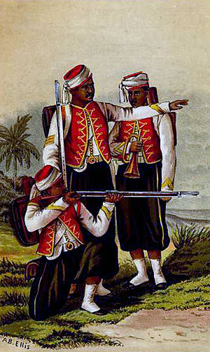
History that needs to be re/told
Colonised Africans/Caribbeans fought and died in WW1 & WW2
The creation of the British West Indies Regiment was formalised by Army Order number 4 of 1916. This had been passed on 3 November 1915. The Order stated that the regiment would be recognised as a corps for the purposes of the Army Act.
Notes:
9) Africans fought in both World Wars on the side of Britain, their ‘mother country’. Colonised Africans/Caribbeans fought and died in WW1 & WW2.
The creation of the British West Indies Regiment was formalised by Army Order number 4 of 1916. This had been passed on 3 November 1915. A total of 397 officers and 15,204 men, representing all Caribbean colonies, served in the BWIR. Of the total, 10,280 (66%) came from Jamaica

Slide 15
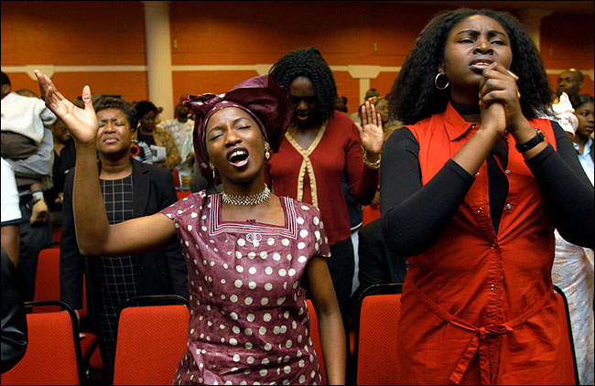
History that needs to be re/told
‘Windrush’ launched Multicultural Britain and Black Christian/Church Movement in Britain
Notes:
10) No African History can be complete without the story of the Black Church Movement in Britain. SS Empire ‘Windrush’ which landed at Tilbury on 22 June 1948 with its 492 mostly Jamaican passengers launched Multicultural Britain and Black Christian/Church Movement in Britain, according to Trevor and Mike Phillips. Today Black Christians are most evident as a Pentecostal Movement but are Catholics, Anglicans, Baptists, Methodists, Seventh Day Adventists, etc too. Mega Churches in London testify to the power of presence of the Black Church Movement in Britain.

Slide 16
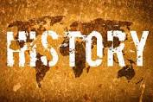
Black History Month
BHM seeks not to replace but supplement and act as a corrective to better history as ‘A Time to Speak’ (Paul Grant & Raj Patel)
Notes:
So, Black History Month provides a focus for us to re-think Black History as a component and contributory to human history. BHM seeks not to replace but supplement and act as a corrective to better history and in the words of Paul Grant and Raj Patel, it provides ‘A Time to Speak’.

